Slide 1

DC-DC Converter for PV Module Integration
Group 760

Slide 2

CONTENT
INTRODUCTION
CONVERTER DESIGN
MPPT ALGORITHM
TESTS RESULTS
DISCUSSION
CONCLUSION

Slide 3
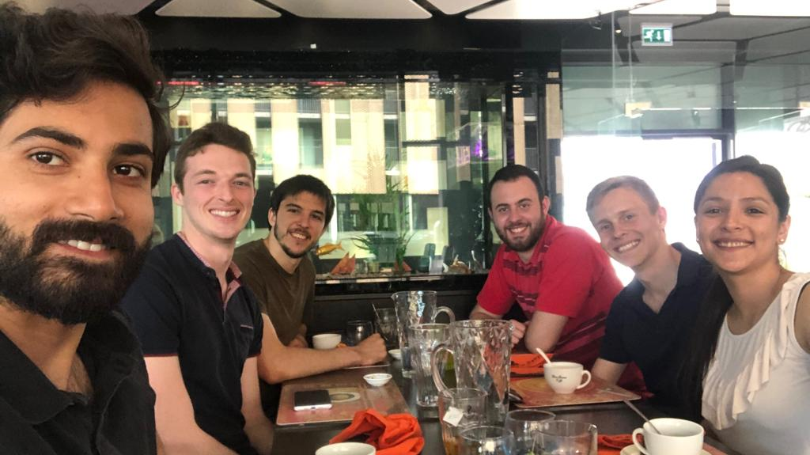
Introduction
Group PED 841
Mihai Rusu
Aitor Teran
Nicolai Fransen
Nicolas Murguizur Bustos
Estefania Ruiz
Faheem Ahmad

Slide 4
Agenda
Slide
of 59
Motivation & objectives
Induction machine
Batteries
Interface board
Inverter
Control of the induction machine
Simulation results
Regenerative braking
Firmware
Setup
Test results
Future work
Conclusions
Thassilo

Slide 5
Motivation and objectives
Slide
of 59
Develop a control algorithm for the power train of an electrical go kart
Design and simulation of a field oriented control (FOC) algorithm
Implement FOC in a digital signal processor (DSP)
Design an interface board and a Graphical User interface (GUI)
Perform tests on the inverter
Modelling the batteries pack
Test control strategy in an experimental setup
Develop a well organized project management strategy
Thassilo

Slide 6
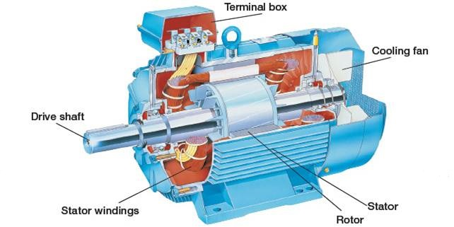
Induction machine
Slide
of 59

Slide 7
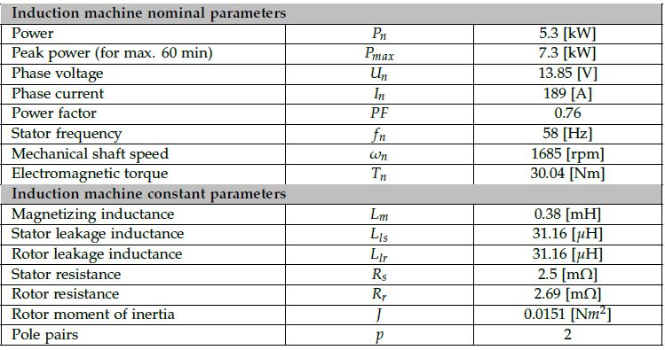
TSA170-210-038 Sauer Danfoss
Slide
of 59

Slide 8
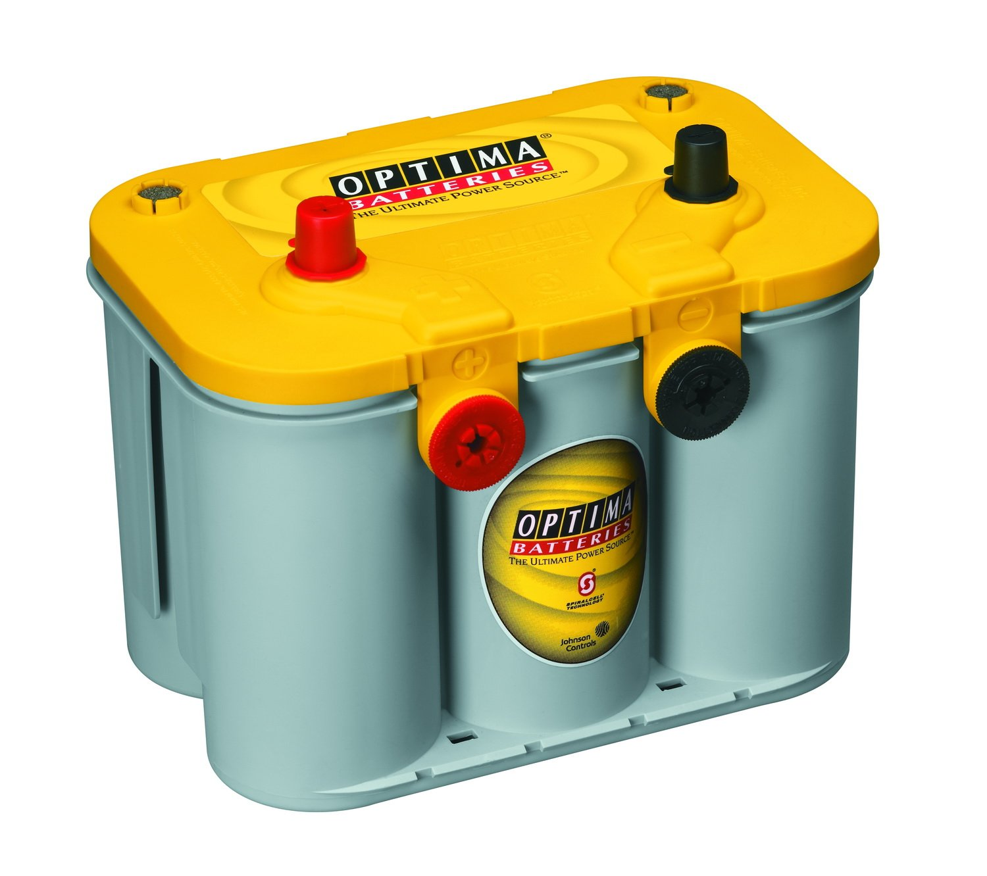
Batteries

Slide 9
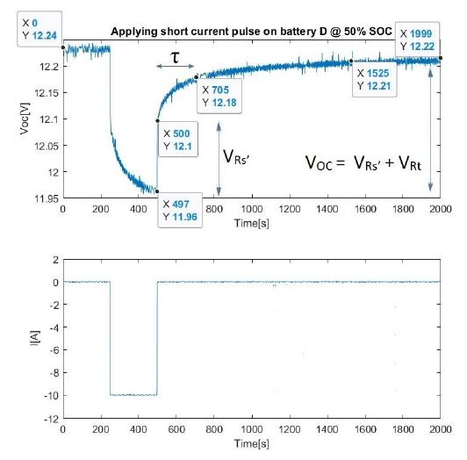
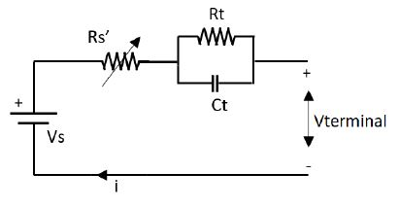
Batteries – obtaining parameters
Why short pulse test?
Points of interest
Goal

Slide 10
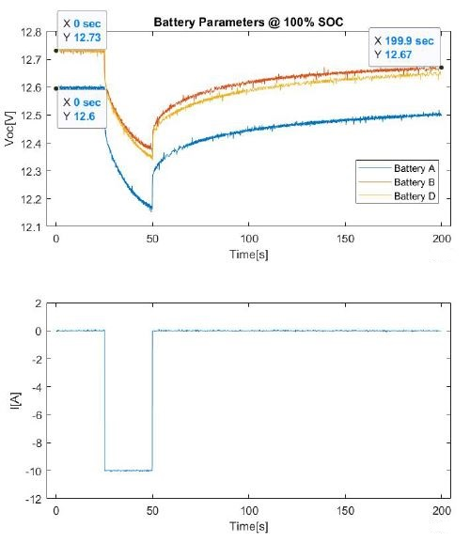
Batteries – experimental parameters
Why not enough waiting period?
Useful information
Observations

Slide 11
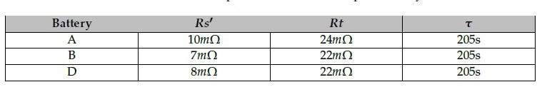
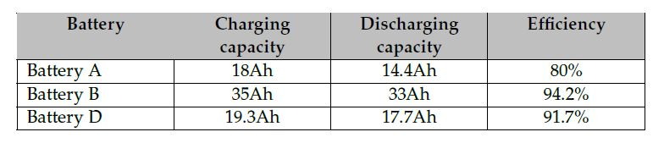
Batteries – experimental parameters

Slide 12
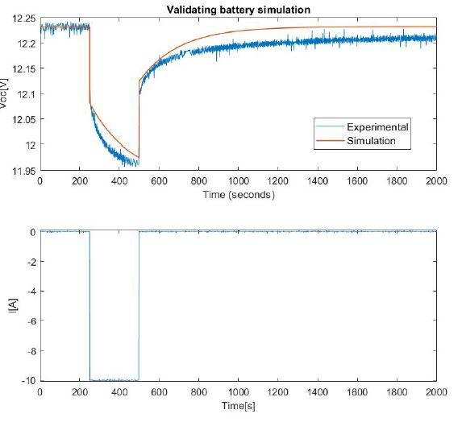
Batteries – simulation result
Observations
Is it satisfactory?
What can be improved?

